Slide 1
ERP and Usability
Dr. Imran Mahmud

Slide 2
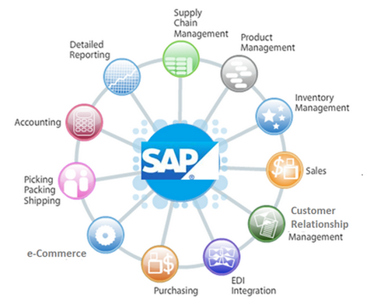
ERP Definition
An ERP system can be defined as a software package that permits integration of all company information, including information related to the several business units in an organization, such as finance, accounting, production and human resources etc.

Slide 3
Global market of ERP
The global enterprise resource planning (ERP) software market is forecast to grow to around 97 billion U.S. dollars by 2024. SAP and Oracle are two of the leading vendor in the market)
The global ERP software market was valued at $35.81 billion in 2018, and is projected to reach $78.40 billion by 2026.

Slide 4
SAP ERP Modules

Slide 5
Benefits

Slide 6
Disadvantages

Slide 7
User Interface

Slide 8
User Interface

Slide 9
Cost and ERP Life

Slide 10
Usability
Usability is the ease of use and learnability of a human-made object such as a tool or device. In software engineering, usability is the degree to which a software can be used by specified consumers to achieve quantified objectives with effectiveness, efficiency, and satisfaction in a quantified context of use.

Slide 11
System usability scale (SUS)
SUMI (Software Usability measurement inventory)
QUIS (Questionnaire for user interaction satisfaction)

Slide 12
SUS questionnaire
I think that I would like to use this system frequently.
I found the system unnecessarily complex.
I thought the system was easy to use.
I think that I would need the support of a technical person to be able to use this system.
I found the various functions in this system were well integrated.
I thought there was too much inconsistency in this system.
I would imagine that most people would learn to use this system very quickly.
I found the system very cumbersome to use.
I felt very confident using the system.
I needed to learn a lot of things before I could get going with this system.

Slide 13
SUS Score
Scoring SUS
For odd items: subtract one from the user response.
For even-numbered items: subtract the user responses from 5
This scales all values from 0 to 4 (with four being the most positive response).
Add up the converted responses for each user and multiply that total by 2.5. This converts the range of possible values from 0 to 100 instead of from 0 to 40.
See the example of BUX

Slide 14
Strongly Disagree | Disagree | Neutral | Agree | Strongly Agree
1 | 2 | 3 | 4 | 5
1 | I think that I would like to use this system frequently. | 1 2 3 4 5 | User response -1
2 | I found the system unnecessarily complex | 1 2 3 4 5 | 5- User response
3 | I thought the system was easy to use. | 1 2 3 4 5 | User response -1
4 | I think that I would need the support of a technical person to be able to use this system | 1 2 3 4 5 | 5- User response
5 | I found the various functions in this system were well integrated | 1 2 3 4 5 | User response -1
6 | I thought there was too much inconsistency in this system. | 1 2 3 4 5 | 5- User response
7 | I would imagine that most people would learn to use this system very quickly | 1 2 3 4 5 | User response -1
8 | I found the system very cumbersome to use. | 1 2 3 4 5 | 5- User response
9 | I felt very confident using the system | 1 2 3 4 5 | User response -1
10 | I needed to learn a lot of things before I could get going with this system. | 1 2 3 4 5 | 5- User response
4-1=3
5-2=3
5-1=4
5-1=4
4-1=3
5-2=3
3-1=2
5-2=3
5-1=4
5-3=2

Slide 15
SUS Score
27 * 2.5= 67.5
Recommended Range 0-64 Not acceptable 65-84 Acceptable 85-100 Excellent
The usbaility result of BUX is acceptable

